Slide 1
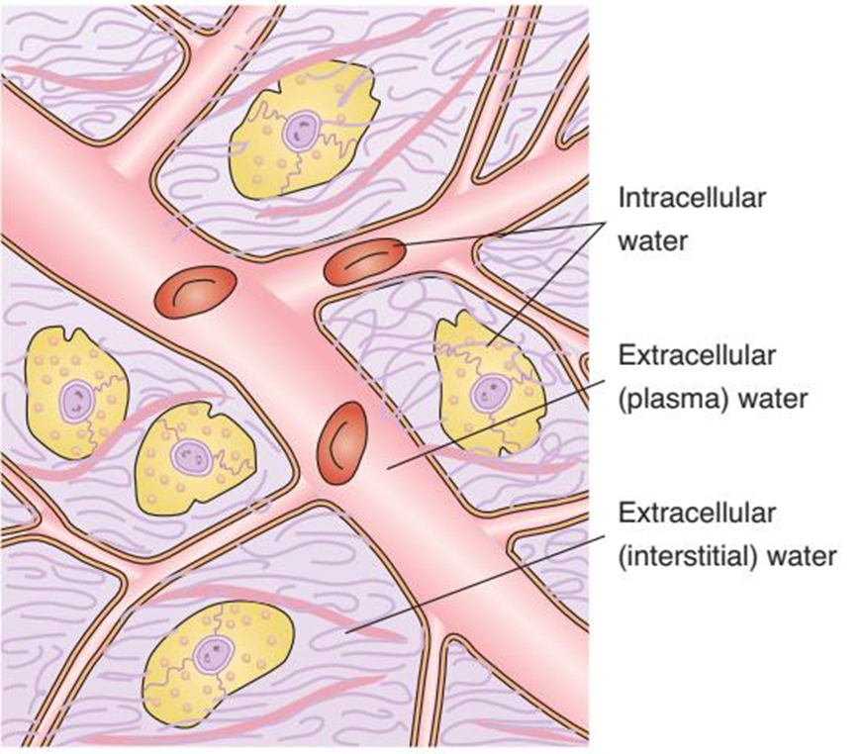
Body Fluid Composition
Dr. Moustafa Al-Shammari

Slide 2
Body fluid composition
Body fluid composition is essential for understanding how fluids are distributed and regulated in the body. Here’s a breakdown:
Main Fluid Compartments:
Intracellular Fluid (ICF): Comprises about 40% of body weight.
Extracellular Fluid (ECF): Divided into:
  Intravascular Fluid (plasma): Accounts for about 5% of body weight.
  Interstitial Fluid: Makes up around 25% of body weight.

Slide 3
Body fluid composition
Water Proportion by Age:
In a term newborn, water constitutes about 78% of body weight.
This decreases to approximately 60% in adults.
Water Balance:
Depends on intake, output, and metabolic usage.
Water is typically lost via:
  Skin
  Lungs
  Intestine
  Kidneys

Slide 4
Body fluid composition
Cell Membrane Permeability:
Cell membranes are relatively permeable to water, potassium (K⁺), and chloride (Cl⁻).
They are relatively impermeable to sodium (Na⁺), phosphate (PO₄³⁻), and proteins.
Sodium (Na⁺) is actively transported out of cells via sodium pumps, which require energy.

Slide 5
Body fluid composition
Fluid Movement and Equilibrium:
Tonicity, hydrostatic pressure, and colloid osmotic pressure between plasma and interstitial fluid help maintain fluid balance.
At the arterial end of capillaries, water exits under hydrostatic pressure.
At the venous end, water is drawn back in by plasma oncotic pressure.
Notes:
Tonicity:
Tonicity refers to the relative concentration of solutes in a solution, influencing the direction of water movement across a semi-permeable membrane.
Solutions can be isotonic (equal concentration), hypotonic (lower solute concentration outside the cell, causing water to move into the cell), or hypertonic (higher solute concentration outside, causing water to move out).
Hydrostatic Pressure:
This is the pressure exerted by a fluid in a closed system, such as blood inside blood vessels.
In capillaries, hydrostatic pressure pushes water and small molecules out of the blood into the interstitial space, particularly at the arterial end of capillaries.
Example: At the arterial end of capillaries, the blood's hydrostatic pressure is higher than the surrounding interstitial fluid, causing water and nutrients to filter out into surrounding tissues.
Colloid Osmotic (Oncotic) Pressure:
This pressure is generated by large proteins (primarily albumin) in the blood plasma, which exert a pulling force, drawing water back into capillaries.
At the venous end of capillaries, colloid osmotic pressure becomes the dominant force, helping to draw water and waste products back into the bloodstream.

Slide 6
Body fluid composition
Plasma Osmolality:
Plasma osmolality remains fairly constant, typically between 285 and 300 mOsmol/kg H₂O, helping maintain cellular homeostasis and fluid balance.
🔴 High Plasma Osmolality (> 300 mOsm/kg H₂O) – Dehydration
Causes: Excessive sweating, vomiting, diarrhea, uncontrolled diabetes.
Effects: Cells shrink due to water loss, leading to confusion, weakness, and possible coma.
🔵 Low Plasma Osmolality (< 285 mOsm/kg H₂O) – Overhydration
Causes: Excessive water intake, kidney disease, SIADH (syndrome of inappropriate ADH secretion).
Effects: Cells swell, which can lead to brain swelling (cerebral edema), headaches, seizures, and coma.
Notes:
Plasma Osmolality and Its Role in Homeostasis
Plasma osmolality refers to the concentration of solutes (such as sodium, glucose, and urea) in the blood plasma. It is crucial for maintaining fluid balance, cellular function, and overall homeostasis.
1. Normal Plasma Osmolality Range
The normal range is 285–300 mOsmol/kg H₂O.
This balance ensures that cells neither shrink (dehydrate) nor swell (overhydrate) due to fluid movement.
2. Factors That Affect Plasma Osmolality
Plasma osmolality depends on:
Sodium (Na⁺): The primary determinant, as sodium attracts water and regulates extracellular fluid balance.
Glucose: Contributes to osmolality, especially in conditions like diabetes.
Urea: A metabolic waste product that influences osmolality but does not drive water movement as strongly as sodium.
3. How Plasma Osmolality Regulates Fluid Balance
To maintain osmolality within the normal range, the body uses two key mechanisms:
✅ 1. Thirst Mechanism (Water Intake)
When osmolality increases (dehydration), the brain’s hypothalamus detects the change and triggers thirst.
Drinking water dilutes plasma, restoring normal osmolality.
✅ 2. Antidiuretic Hormone (ADH) – Water Retention
The pituitary gland releases ADH when osmolality is high.
ADH signals the kidneys to retain water, reducing urine output and diluting plasma.
When osmolality is low (overhydration), ADH secretion decreases, leading to more water excretion.

Slide 7
Calculating Pediatric Fluid Needs
Calculating pediatric fluid needs is essential for ensuring adequate hydration, especially for children in clinical settings. Here’s a summary of the maintenance fluid calculation method based on weight, as adapted from South & Isaacs (2012):

Slide 8
Pediatric Maintenance Fluid Calculation
For children under 10 kg:
Fluid requirement: 100 ml per kilogram of body weight per day
Formula: Fluid needs=Weight in kg×100 ml/kg/day
Example: For a child weighing 7 kg: 7 kg×100 ml=700 ml/day

Slide 9
For children weighing 10–20 kg:
Fluid requirement: 1,000 ml for the first 10 kg + 50 ml per kilogram for every kg over 10
Formula: Fluid needs=1000 ml+(50 ml/kg×(Weight in kg ))
Fluid needs=1000 ml+(50 ml/kg×(Weight in kg ))
Example: For a child weighing 15 kg: 1000 ml+(50 ml×5 kg)=1250 ml/day

Slide 10
For children weighing more than 20 kg:
Fluid requirement: 1,500 ml for the first 20 kg + 20 ml per kilogram for every kg over 20
Formula: Fluid needs=1500 ml+(20 ml/kg×(Weight in kg )) Example: For a child weighing 24 kg: 1500 ml+(20 ml×4 kg)=1580 ml/day

Slide 11
Hourly Maintenance Fluid Calculation
To calculate the hourly maintenance fluid requirement and fluid deficit for a child, here are the formulas broken down by weight range:
For the first 10 kg of body weight:
Requirement: 4 mL/kg per hour
Formula: Hourly fluid needs=Weight in kg×4 mL/kg

Slide 12
For children weighing 11–20 kg:
Requirement: 40 mL/hr for the first 10 kg + 2 mL/kg per hour for each kg over 10
Formula: Hourly fluid needs=40 mL+(2 mL/kg×(Weight in kg )) Example: For a child weighing 15 kg : 40 mL+(2 mL×5 kg)=50 mL/hr

Slide 13
For children weighing above 20 kg:
Requirement: 40 mL/hr for the first 10 kg + 20 mL/hr for the next 10 kg + 1 mL/kg per hour for each kg over 20
Formula: Hourly fluid needs=40 mL+20 mL+(1 mL/kg×(Weight in kg )
Example: For a child weighing 24 kg: 40 mL+20 mL+(1 mL×4 kg)=64 mL/hr

Slide 14
Daily and Hourly Maintenance Fluid Requirements
Weight | Daily Maintenance Requirement | Hourly Maintenance Requirement
1-10 kg 100 ml/kg | 100 mL/kg | 4 mL/kg
11-20 kg | 1000 ml plus 50 ml/kg for each kg >10 kg | 2 mL/kg + 2 mL/kg for each kg >10 kg
>20 kg | 1500 ml plus 20 ml/kg for each kg >20 kg | 1 mL/kg + 1ml/kg for each kg >20 kg

Slide 15
Fluid Deficit Calculation
The volume of fluid deficit may then be calculated using the following
formula:
Calculated fluid deficit (mL) = %dehydration ×weight (kg) × 10

Slide 16
Fluid Deficit Calculation
% Dehydration
This is an estimated percentage based on the degree of dehydration (mild, moderate, or severe).
It is calculated using weight loss or clinical signs.
weight loss Example:
  If a child’s normal weight is 12 kg, but now weighs 11.2 kg, the weight loss is 0.8 kg.
  % Dehydration = (0.8 kg ÷ 12 kg) × 100 = 6.7% (~7%).

Slide 17
clinical signs
• Mild Dehydration (3-5% in infants, 3-4% in children):
Minimal symptoms; normal pulse, breathing, blood pressure, and behavior
Slight thirst; moist mucous membranes
Tears and urine output present

Slide 18
clinical signs
• Moderate Dehydration (6-9% in infants, 6-8% in children):
Increased pulse, faster breathing (tachypnea)
Irritable, more thirsty
Dry mucous membranes, decreased tears
Delayed capillary refill (2-4 sec), oliguria (low urine output)

Slide 19
clinical signs
• Severe Dehydration (≥10% in infants, 10% in children):
Very increased pulse, deep rapid breathing (hyperpnea), and possible shock
Hyperirritable or lethargic
Absent tears, sunken eyes, sunken fontanel
Very delayed capillary refill (>4 sec), cold/mottled skin
Oliguria or anuria (no urine production)

Slide 20
Fluid Deficit Calculation
Calculated fluid deficit (mL) = %dehydration ×weight (kg) × 10
e.g. 7% dehydration in a 12 kg child
= 7 × 12 × 10 = 840 mL deficit.

Slide 21
How to Use This in Clinical Practice
• Assess the child’s dehydration status (mild, moderate, or severe).
• Determine weight and dehydration percentage based on clinical signs.
• Apply the formula to estimate fluid deficit.
• Plan fluid replacement therapy based on severity:
Mild: Oral Rehydration Therapy (ORT)
Moderate/Severe: IV fluids (e.g., normal saline or Ringer's lactate)

Slide 22
1. Oral Rehydration Therapy (ORT) for Mild to Moderate Dehydration
Guidelines:
Mild dehydration → 50 mL/kg ORS over 4–6 hours.
Moderate dehydration → 100 mL/kg ORS over 4–6 hours.
Ongoing losses (e.g., diarrhea) → 10 mL/kg ORS per stool.

Slide 23
1. Oral Rehydration Therapy (ORT) for Mild to Moderate Dehydration
Key Considerations:
Administer small amounts (2–5 mL every 2–3 minutes) if the child refuses or has nausea.
Ondansetron (Zofran) may reduce vomiting and improve ORS tolerance.
Use commercial ORS solutions (e.g., Pedialyte, WHO ORS) to enhance sodium and water absorption.
For children resistant to drinking fluids, frozen ORS (popsicles) or flavoring agents can improve compliance.

Slide 24
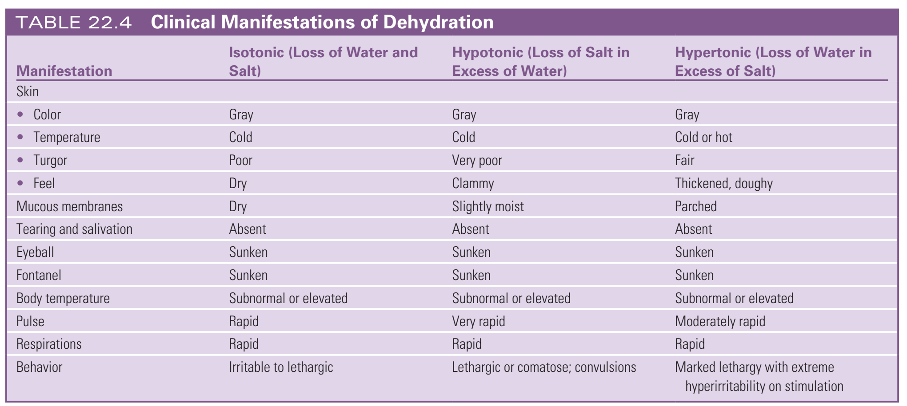
2. Parenteral Fluid Therapy for Severe Dehydration
Notes:
Isotonic (Common in diarrhea, vomiting) Equal loss of water and sodium
Hypotonic (Common in excessive free water intake, vomiting, prolonged diarrhea, diuretics)More sodium loss than water → Water shifts into cells, causing cell swelling
Hypertonic (Common in excessive sweating, diabetes insipidus, severe fever, inadequate fluid intake)More water loss than sodium → Water shifts out of cells, causing cell shrinkage

Slide 25
Types of IV Solutions
1. Crystalloids
Isotonic Solutions: Expand intravascular compartment. Examples include:
  D5W
  0.9% NaCl (Normal Saline)
  Ringer’s solution
  Lactated Ringer’s solution

Slide 26
Hypertonic Solutions: Expand the intravascular compartment more significantly and draw fluid from other areas. Examples include:
  D10W
  3% NaCl
  5% NaCl
  D5 0.45% NaCl
  D5 0.9% NaCl

Slide 27
Hypotonic Solutions: Cause fluid to shift from intravascular spaces into cells. Examples include:
  D2.5W
  0.45% NaCl
  0.33% NaCl

Slide 28
Colloids
Used if blood volume doesn’t improve with crystalloids. Examples include:
  Albumin (5% and 25%)
  Plasma protein fraction
  Dextran
Notes:
Examples of Colloids:
TypeDescriptionIndicationsAlbumin (5% and 25%)A natural plasma protein that increases oncotic pressure.Used in hypovolemia, hypoalbuminemia, burns, and liver disease. 5% albumin is for volume expansion, while 25% is for severe hypoalbuminemia.Plasma Protein Fraction (PPF)Derived from human plasma; contains albumin and globulins.Used in shock, burns, and trauma when rapid plasma volume expansion is needed.DextranA synthetic colloid that expands plasma volume.Used in hypovolemic shock but less commonly due to risk of anaphylaxis and bleeding tendencies.

Slide 29
Energy/Calorie Requirements
Macronutrient Caloric Content:
  Carbohydrates and proteins: 4 kcal/g; Fats: 9 kcal/g

Slide 30
Energy/Calorie Requirements
Caloric Needs by Age:
  Infants (0-6 months): 110-120 kcal/kg/day
  Infants (6 months - 1 year): ~100 kcal/kg/day
  Young Children (1-10 years): ~80 kcal/kg/day
  Older Children: ~60 kcal/kg/day
  Adolescent Boys: ~2,800 kcal/day
  Adolescent Girls: ~2,200 kcal/day

Slide 31
Energy/Calorie Requirements
Macronutrient Caloric Content:
  Carbohydrates and proteins: 4 kcal/g; Fats: 9 kcal/g
  Carbohydrates: Daily calories * 0.40 / 4 = grams of carbs per day.
  Proteins: Daily calories * 0.30 / 4 = grams of proteins per day.
  Fats: Daily calories * 0.30 / 9 = grams of fats per day

Slide 32
Example Calculations:
Infants (0-6 months):example the weight of an infant is 5 kg.
Caloric needs = 110-120 kcal/kg/day
Total caloric needs = 5 kg × 110 kcal/kg = 550 kcal/day (lower end)
Total caloric needs = 5 kg × 120 kcal/kg = 600 kcal/day (upper end)
For macronutrient distribution
Carbohydrates (40%): (550×0.40)/4=55 grams
(600×0.40)/4=60 grams
Proteins (30%): (550×0.30)/4=41.25 grams
(600×0.30)/4=45 grams
Fats (30%): (550×0.30)/4=18.33 grams
(600×0.30)/4=20 grams

Slide 33

Milk Types and Caloric Content
Milk Type
Fat
Carbs
Protein
Calories
Whole Fat Milk
8 g
12 g
8 g
150 kcal
Low Fat Milk
5 g
12 g
8 g
120 kcal
Fat-Free Milk (Skimmed)
1 g
12 g
8 g
~90 kcal

Slide 34
Recommendations:
Whole milk is suitable for children over 12 months.
Low-fat milk (2%) can be given to children over 2 years.
Skim milk is generally not recommended unless there’s a medical need.

Slide 35
Breastfeeding vs. Formula Feeding
✔ Breastfeeding:
10-12 times/day (highly digestible).
Provides 20 kcal/oz.
✔ Formula Feeding:
6 feeds/day, ~2-3 oz per feed.
20 kcal/oz, similar to breast milk.
📌 Example Calculation:
A 3-month-old, 5 kg infant drinks 5-6 oz per feeding (6 times/day):
30 oz/day × 20 kcal/oz = 600 kcal/day
Matches 550-600 kcal/day requirement
Notes:
20 kcal/oz means that each ounce (oz) of breast milk or infant formula provides 20 kilocalories (kcal) of energy.
Explanation:
Kilocalories (kcal) measure energy from food.
1 ounce (oz) ≈ 30 mL
Breast milk and standard infant formula contain 20 kcal per ounce, ensuring proper growth and development.
Example Calculation:
A baby consuming 5 oz per feeding, 6 times a day:
5 oz × 6 feedings × 20 kcal/oz = 600 kcal/day
This meets the daily caloric requirement for infants (110-120 kcal/kg/day).

Slide 36
Formula Adequacy for Infants
Quick Estimation: Infant’s age in months + 2 or 3 = ounces per feeding
  E.g., a 3-month-old takes about 5-6 oz per feeding.
Caloric Content: Both breast milk and commercial formulas contain 20 kcal/oz.

Slide 37
Daily Fluid Intake for Infants: Explanation and Calculation
Infants require higher fluid intake per body weight compared to older children and adults due to their higher metabolic rate, greater insensible water losses, and immature kidneys.
1. Fluid Requirements Based on Weight
General guideline: 75–90 mL per pound (mL/lb) per day
Alternate conversion: 2.5–3 ounces per pound (oz/lb) per day

Slide 38
Daily Fluid Intake for Infants: Explanation and Calculation
2. Example Calculation for a 10 kg (22 lb) Infant
Step 1: Convert Body Weight to Pounds
10 kg = 22 lb
Step 2: Determine Fluid Needs in Ounces
Minimum: 22 lb×2.5 oz/lb=55oz/day
Maximum: 22 lb×3 oz/lb=66 oz/day
Thus, a 10 kg (22 lb) infant needs between 55–66 oz (1,650–1,980 mL) of fluid daily.

Slide 39
Daily Fluid Intake for Infants: Explanation and Calculation
3. Fluid Intake and Caloric Needs
Since breast milk and infant formula provide both fluids and calories, we can estimate the energy intake:
Average caloric content of breast milk or formula = 20 kcal per ounce
Daily energy requirement = fluid intake (oz) × 20 kcal/oz
For our example:
Minimum kcal: 55×20=1,100 kcal/day
Maximum kcal: 66×20=1,320 kcal/day
Therefore, a 10 kg (22 lb) infant consumes approximately 1,100–1,320 kcal/day through breast milk or formula.

Slide 40

Thank you

